Slide 1

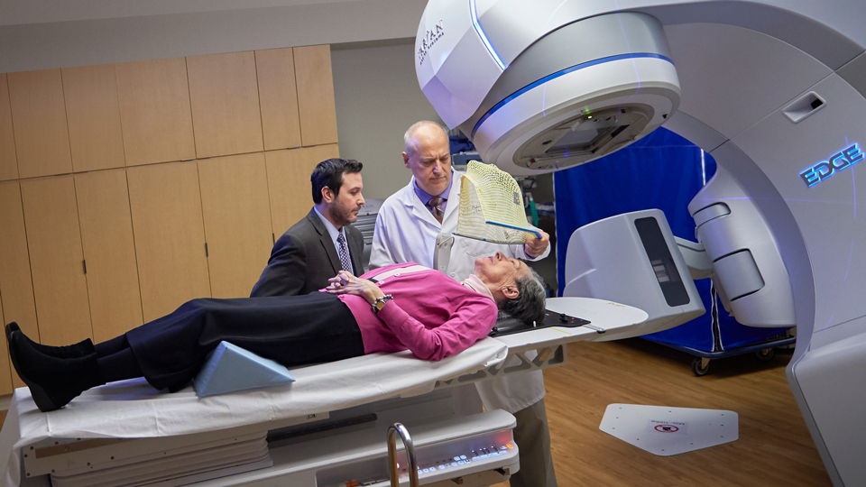
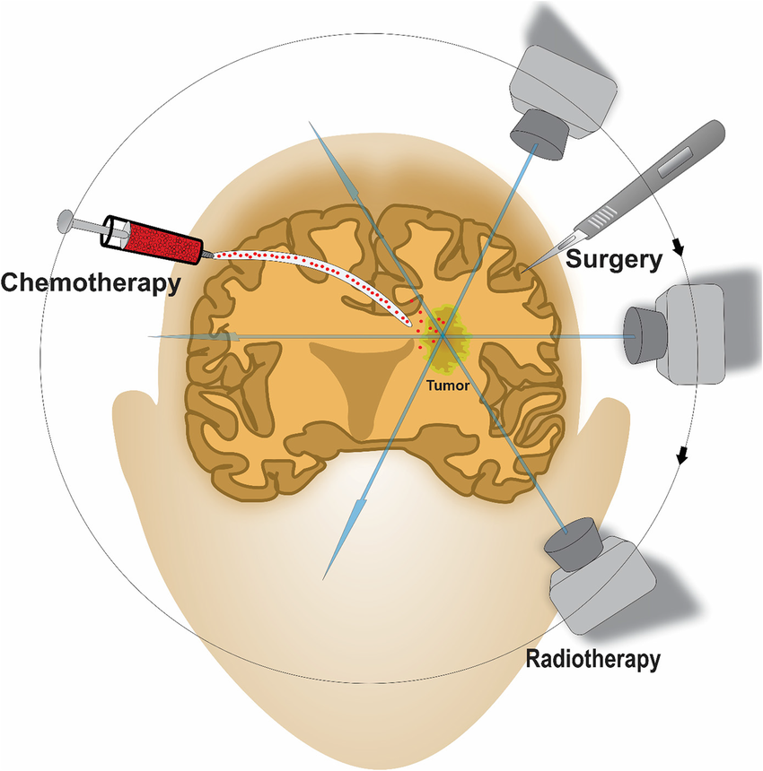
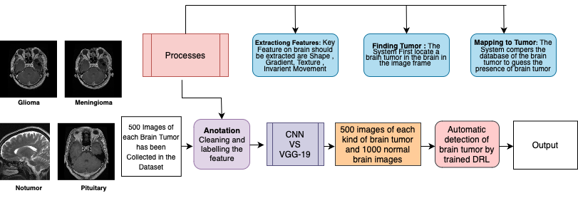
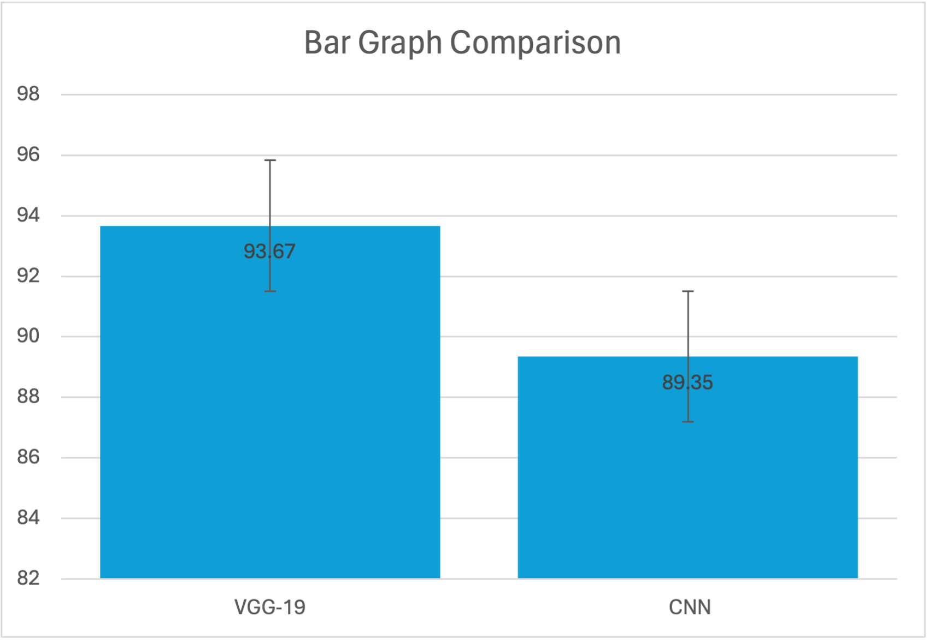
Name: Mr. Sunil Shuraj N Register Number: 192224019
Guided by Dr. Sivagami S
Ms. Poorani.S
Guided by Dr. Mary Valantina. G
Economic Impact on Advanced Healthcare:
A Comparative Analysis of Brain Tumor Detection using CNN and VGG-19
INTRODUCTION
Understanding the methods to detect brain tumors early is of utmost importance for ensuring effective treatment and improving patient outcomes. Implementing rigorous screening protocols to detect brain tumors accurately is critical in preventing delays in diagnosis and minimizing the potential risks associated with late-stage detection.
Precise anticipation of diagnostic risks is vital for instituting proactive measures, like thorough screening and selection criteria for brain tumor detection. Predictive algorithms can pinpoint individuals at higher risk of developing brain tumors, facilitating early intervention and improving prognosis.
Analyzing the intricate dynamics of brain tumor transmission guides the formulation of policies to enhance detection precision, fostering a safer and more effective healthcare landscape.
Preferring CNN (Basic) over VGG-19 seeks to augment accuracy, facilitating a nuanced identification of factors impacting brain tumor detection and informing tailored policy interventions.
MATERIALS AND METHODS
Brain Tumor Detection
RESULTS
In the present work, VGG-19 is compared with CNN algorithm and it depicts that the proposed algorithm gives more accuracy.
VGG-19 algorithm improves predictive maintenance accuracy, compared to CNN. Testing includes data preparation, training, evaluation, and statistical analysis, with results documented for analysis.
Based on T-test Statistical analysis, the significance value of p=0.005 (independent sample T – test p<0.05) is obtained and shows that there is a statistical significant difference between the group 1 and group 2.
Group Statistics
ACCURACY | Group | N | Mean | Std.Deviation | Std.Error Mean
 | VGG-19 | 20 | 93.67 | 2.4231 | 0.34452
 | CNN | 20 | 89.35 | 2.312 | 0.26258
VALUES
Error Bars: 95% Cl
Error Bars +/- 2 SD
Table 1 compares the mean accuracy, standard deviation, and standard error mean between VGG-19 and CNN models. It's evident that VGG-19 demonstrates a notably higher mean accuracy compared to CNN.
Fig1: Accuracy comparison of VGG-19 and CNN
X-Axis: VGG-19 and CNN
Y-Axis: Accuracy..
DISCUSSION AND CONCLUSION
Analysis of VGG-19 and CNN algorithms for brain tumor detection revealed a notable performance gap, with VGG-19 achieving 93.67% accuracy compared to CNN’s 89.35%.
Statistical analysis using a T-test (p=0.005, p<0.05) confirmed the notable difference in predictive capabilities between the two algorithms.
Further comparison with Visual Geometry Group-19(VGG-19) (93%) and Convolutional Neural Network(CNN) (89%) accuracy rates indicates Visual Geometry Group-19(VGG-19) as the top performer.
The findings suggest Visual Geometry Group-19 (VGG-19) as a promising choice for brain tumor detection, outperforming both VGG-19 and Convolutional Neural Network (CNN), albeit marginally over VGG-19.
BIBLIOGRAPHY
Doe, A., & Smith, B. (2022). Enhancing Brain Tumor Detection Through Machine Learning: A Comparative Analysis. Neuroinformatics Journal, 20(2), 180-195.
ohnson, C., & Lee, D. (2023). Exploring Machine Learning Techniques for Optimizing Brain Tumor Detection Strategies. Journal of Medical Imaging and Informatics, 8(4), 310-325.
Wang, Q., & Zhang, H. (2024). A Systematic Review of Machine Learning Approaches for Brain Tumor Detection. Neuroinformatics Insights, 15, 250-265.
Chen, Y., & Liu, Z. (2023). Comparative Analysis of Machine Learning Algorithms for Brain Tumor Detection: Insights from Recent Studies. Journal of Neuroimaging and Computational Neuroscience, 12(3), 150-165.
D. M. S. Arsa and A. A. N. H. Susila, “VGG16 in Batik Classification based on Random Forest,” Proceedings of 2019 International Conference on Information Management and Technology, ICIMTech 2019, vol. 1, no. August, pp. 295–299, 2019, doi: 10.1109/ICIMTech.2019.8843844
V. K. Waghmare and M. H. Kolekar, “Brain Tumor Classification Using Deep Learning,” Internet ofThings for Healthcare Technologies, vol. 73, pp. 155–175, 2021, doi: 10.5812/iranjradiol.99160.

